Slide 1

Mouse Skills
Presented by [Hana Aden]

Slide 2

Introduction
Mouse Basics
Types of Mice
Wired
Wireless
Gaming
Simple

Slide 3
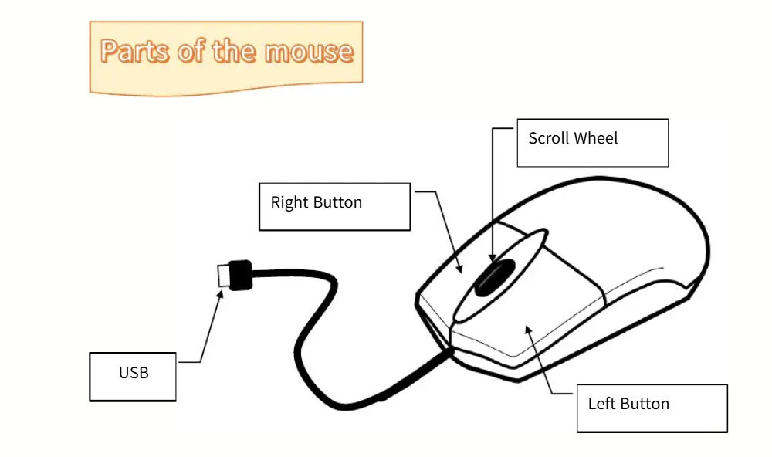

Slide 4

How to Hold the Mouse
Comfortable mouse holding for little hands
Learn the best way to hold your mouse!

Slide 5
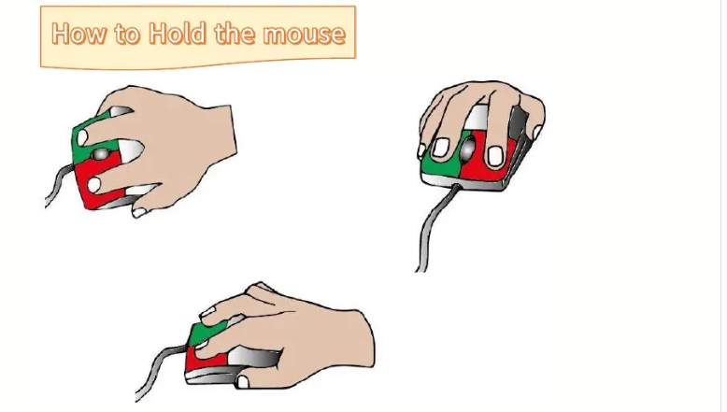

Slide 6
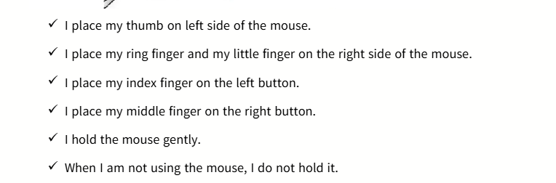
HOW TO USE MOUSE

Slide 7
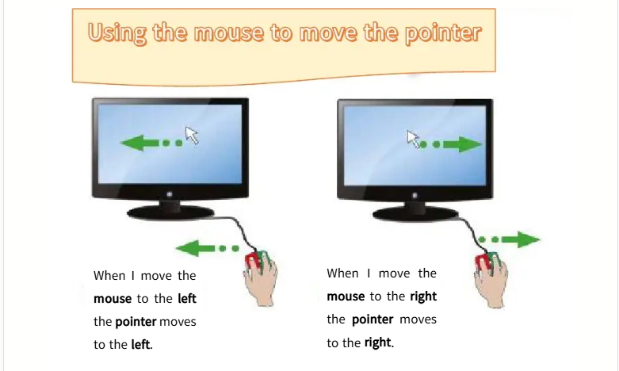

Slide 8

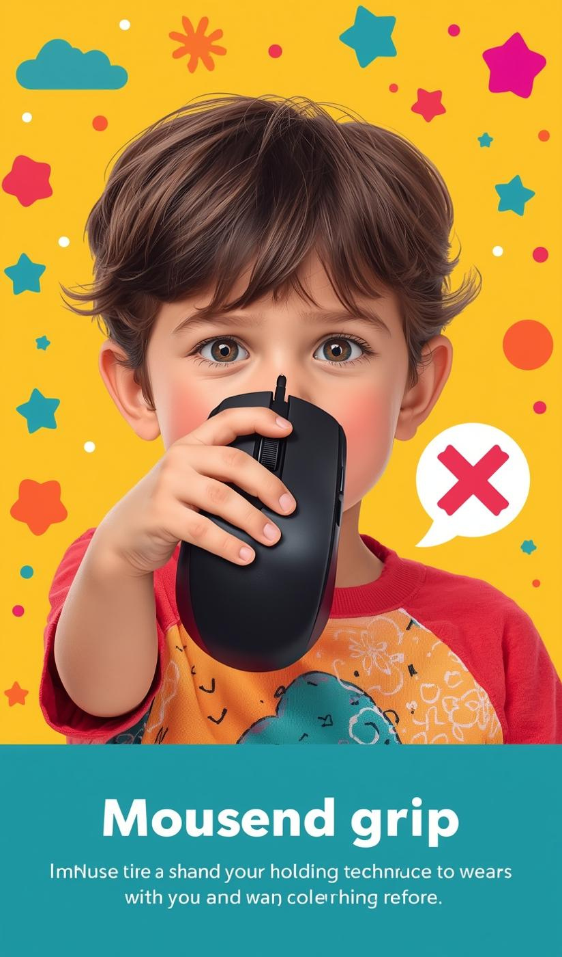
Incorrect Mouse Holding
Avoid these common mistakes when holding a mouse!

Slide 9

Identifying the Mouse Pointer
Spotting the pointer is easy!
The pointer moves when you move the mouse!

Slide 10
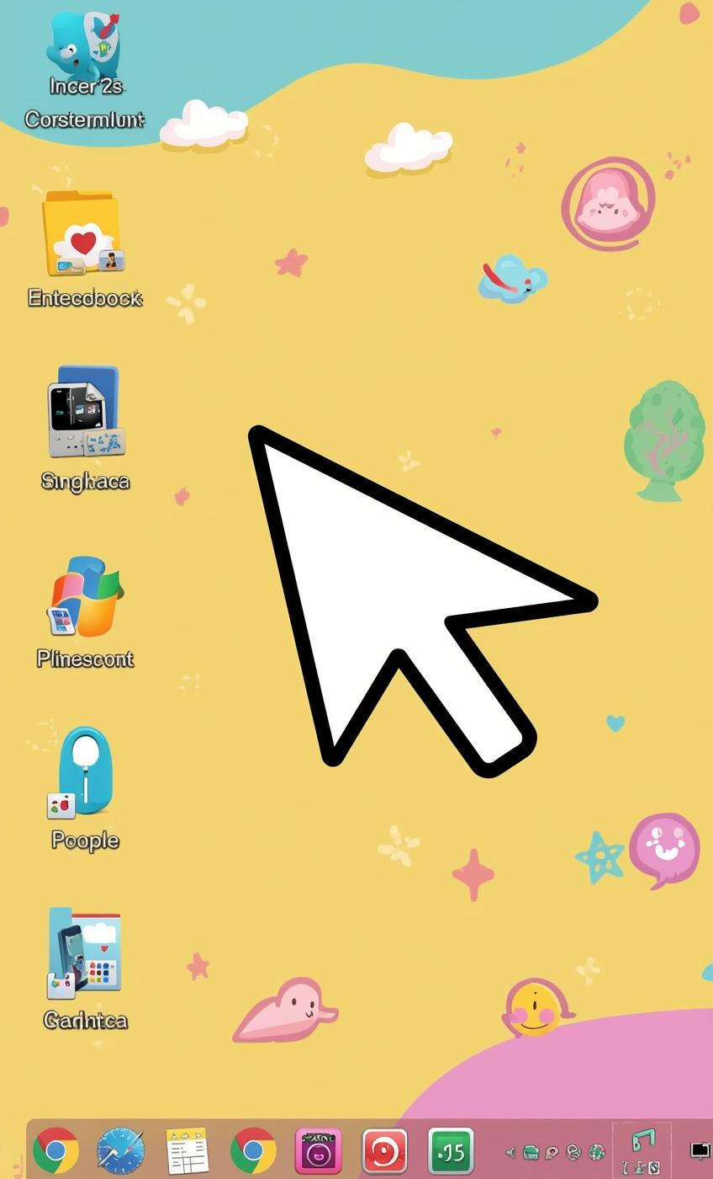
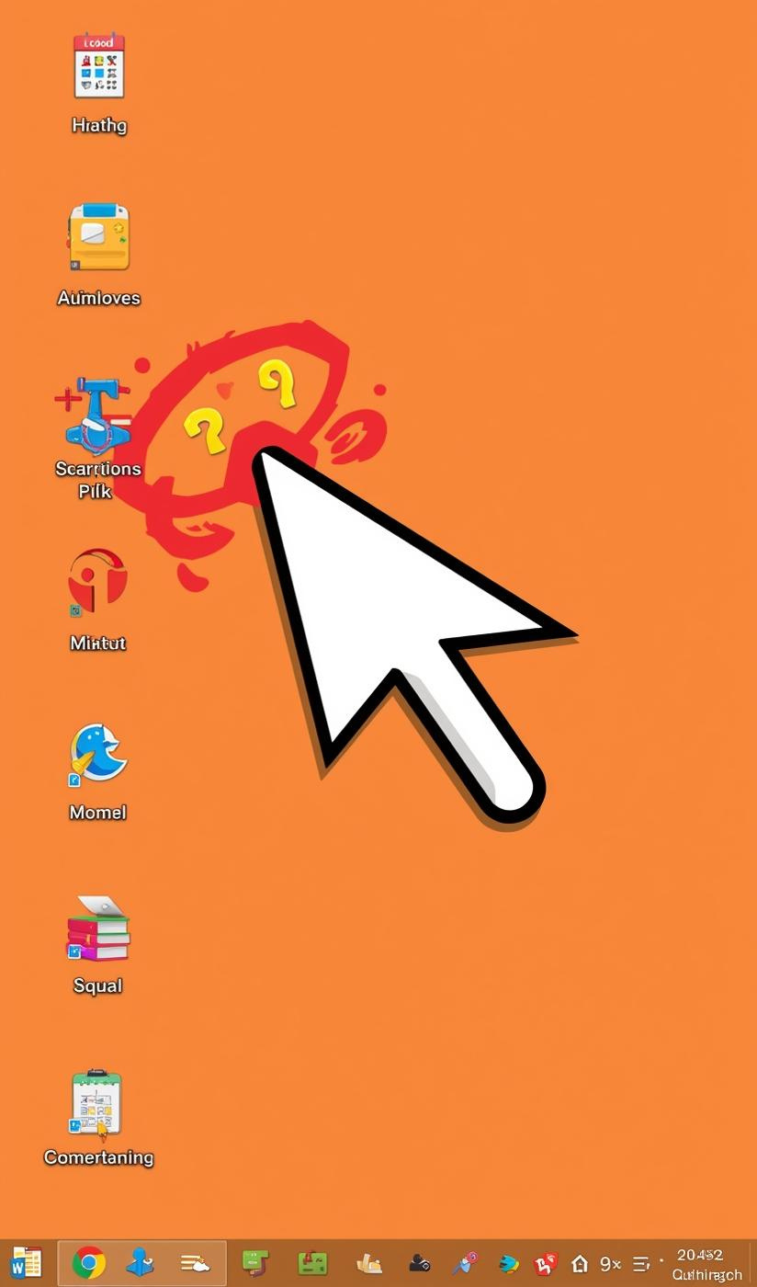
Find the Pointer!
Can you spot the mouse pointer here?

Slide 11

Using the Mouse to Point
Touching objects on your screen
Move the pointer to select icons

Slide 12


Practice Pointing!
Move the mouse to touch objects on screen

Slide 13

Time to Click!
Press and release the mouse button
Clicking lets you open and select items

Slide 14


Try Clicking!
Let's practice clicking colorful buttons together!

Slide 15
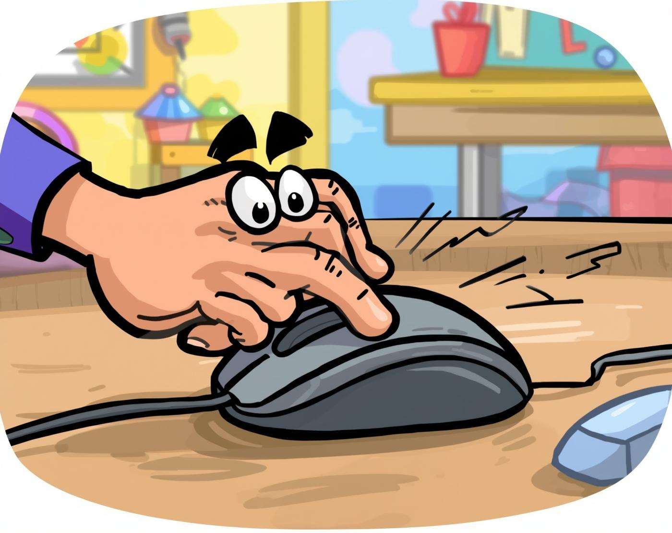
Click Twice Fast!
Learn the secret to double-clicking
Double-click opens files and programs easily

Slide 16


Double-Clicking Made Easy!
Open folders with a quick double-click!

Slide 17

Move Objects with Ease!
Learn to Drag and Drop Like a Pro
Dragging helps you organize your files easily.

Slide 18


Drag and Drop Fun!
Move files and puzzle pieces easily!

Slide 19
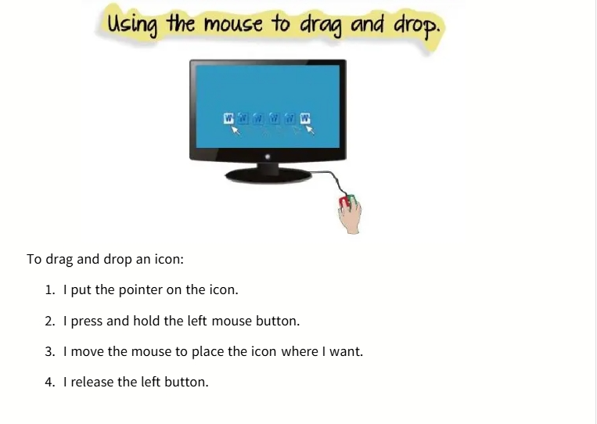

Slide 20

Congratulations!
You've learned how to use the mouse!
Here’s a quick recap:
Holding the mouse correctly
Identifying the pointer
Pointing at objects
Clicking and double-clicking
Dragging and dropping
Keep practicing these skills with fun games and activities!

